Slide 1
Workplace Mental Health Assistance
Data Engineering Track
Mai Le, Okechukwu Odunze & Stephanie Samperio

Slide 2
About the Dataset.
Mental Health at Workplace Survey (CSV)
This dataset is from a 2014 survey that measures attitudes towards mental health and frequency of mental health disorders in the tech workplace.

Slide 3
ETL - Extract, Transform,Load
Extract
Transform
Changed column names
Removed unneeded columns
Cleaned the gender column
Cleaned age column
Created new CSV for each team member
Load
Loaded CSV’s into a SQL database
Notes:
The gender column previously had 46 different type of answers.

Slide 4
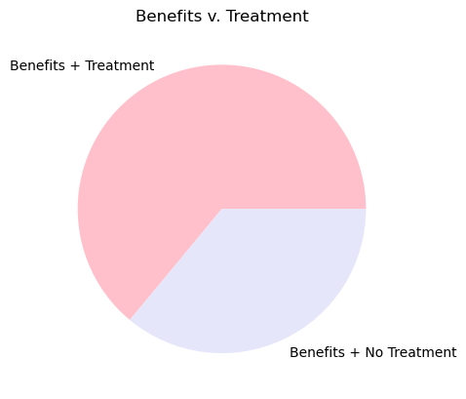
If the workplace offers mental health assistance are employees more likely to seek treatment?
302
170
Notes:
This graphs shows that workers who have benefits are more likely to get treatment. The way I found that out was by creating two data frames, one had all workers who had benefits and the second one was all workers with no benefits then I found how many of those how treatment using loc. So 472 workers had benefits in total, 302 workers got mental health treatment while 170 did not.

Slide 5
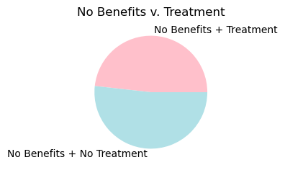
If the workplace offers mental health assistance are employees more likely to seek treatment?
178
191
Notes:
This graph shows how many workers did not have benefits and wheter they got treatment or not. I found this information to be able to compare and confirm that workers who had benefits get more treatment. So 369 workers had no benefits, 178 of those got treatment while 191 didnt.

Slide 6
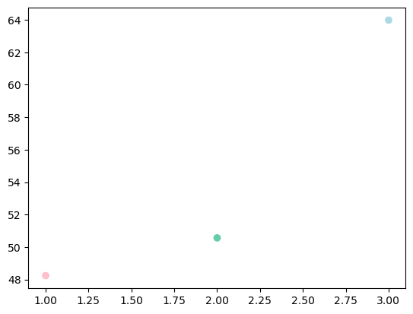
If the workplace offers mental health assistance are employees more likely to seek treatment?
1. No Benefits, Yes Treatment (48%)
2. Average of how many people got treatment in general (50%)
3. Yes Benefits, Yes Treatment (64%)
Conclusion: On average, workers who have benefits get treatment more often.
Notes:
The scatter plot shows both graphs in comparison to the average of how many people got treatment in general. The average combines the workers who got treatment whether they had benefits or not.

Slide 7
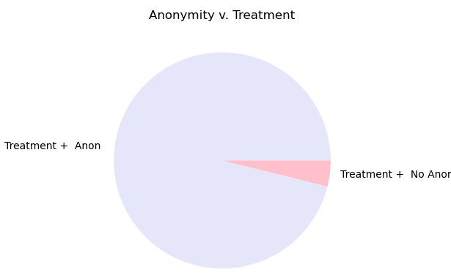
If the worker is anonymously protected are they more likely to seek out help from the workplace?
When anonymity is protected, there is a higher chance that workers with benefits will most likely seek treatment. Specifically gathered from the data, 6 individuals got mental health treatment when anonymity was not protected, whereas 146 people got treatment when anonymity was offered.
146
6

Slide 8
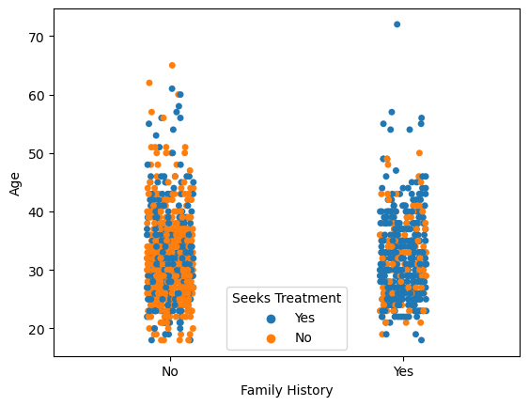

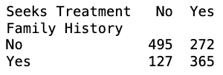
Do individual with history of mental illness in the family more likely to reach out for help?
With And Without Benefits
When individuals that do have family members with mental illness are more likely to go get help for their own mental health.

Slide 9
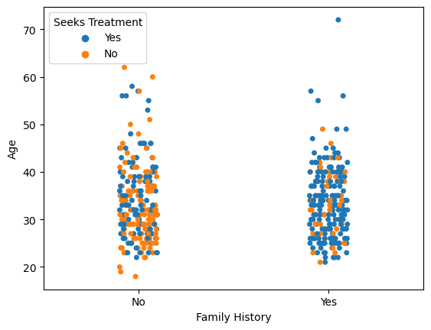
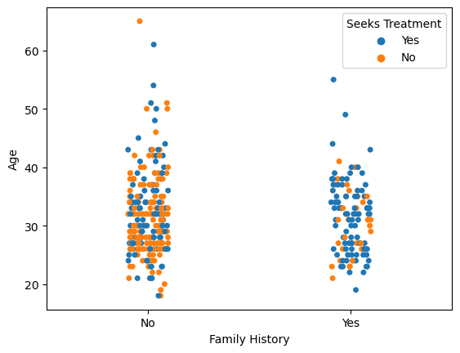

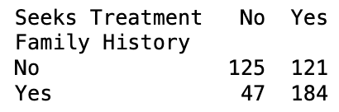
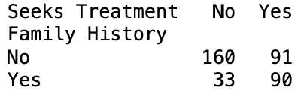
Do individual with history of mental illness in the family more likely to reach out for help?
Without Benefits
With Benefits

Slide 10
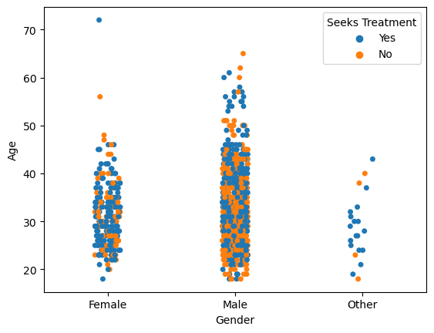
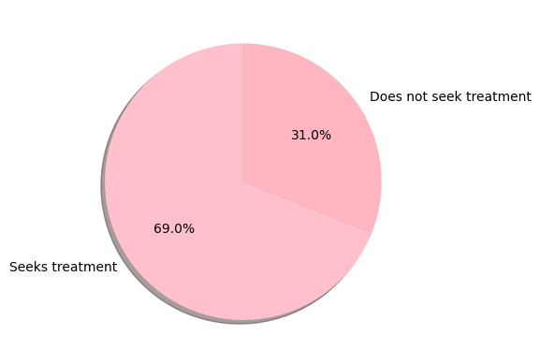
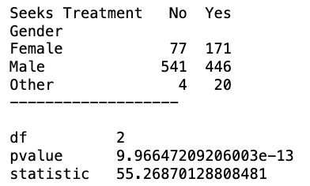
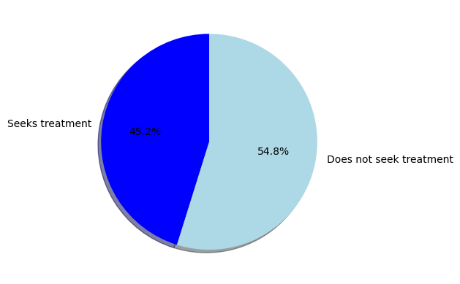
Does gender affects the likelihood of the individual to get help for mental health?
H0 : Gender and seeking treatment has no correlation with each other.
H1 : Gender and seeking treatment do correlation with each other.

Slide 11
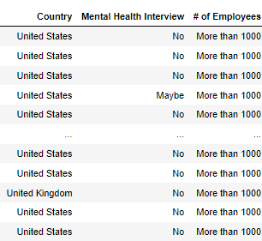


Do Countries with 500 employees discuss about mental Health illness?
Employees in the United states are not able to access Mental Health with 251 No, and 6 Yes,

Slide 12
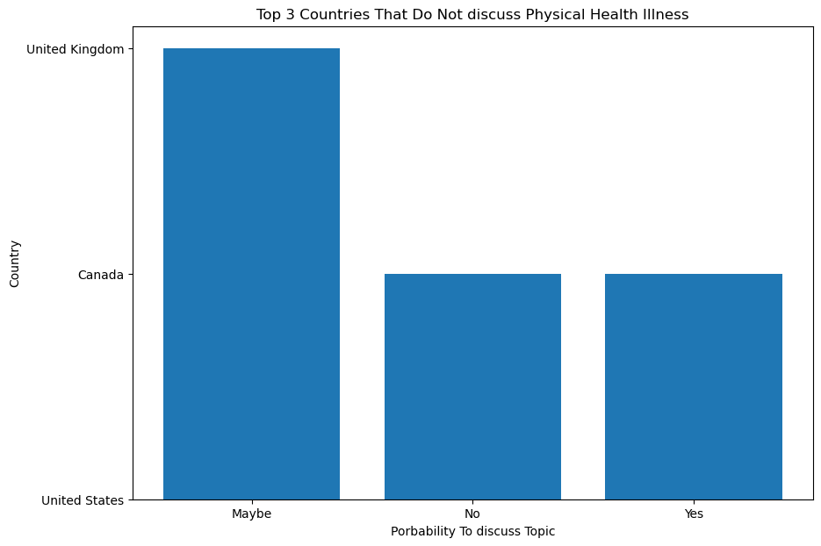


Do employees Discuss physical illnesses in the workplace?
A large number of employees may or not discuss their physical health conditions around their workplace. With a small amount who are willing to discuss their Physical Health condition.

Slide 13
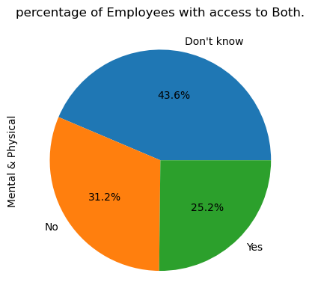



How many employers care about both mental and physical illnesses?
Based off a worldwide view both Mental and Physical Health, show a percentage of employees to not be able to speak about either of these condition.
Notes:
Mental and Physical Health is critical Health conditions and it can be a very Sensitive topic for people to openly talk about at the workplace. However through this Dataset, we see that during the year 2014 - 2016 employees were not able to speak about the health conditions and as thier employers don’t often create avenues for their employees to speak about this conditions

